Slide 1
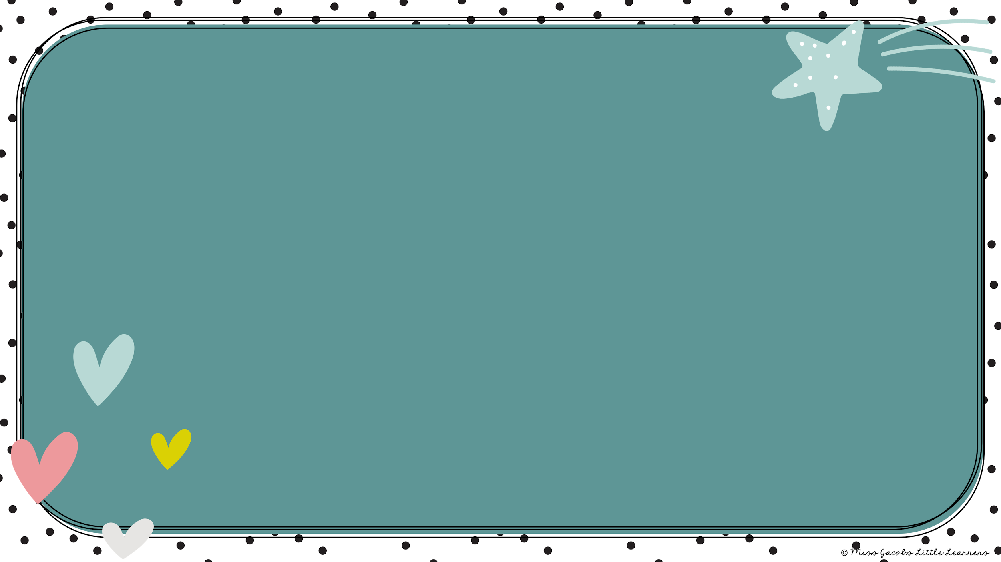
Kindergarten
Words

Slide 2

I

Slide 3

the

Slide 4
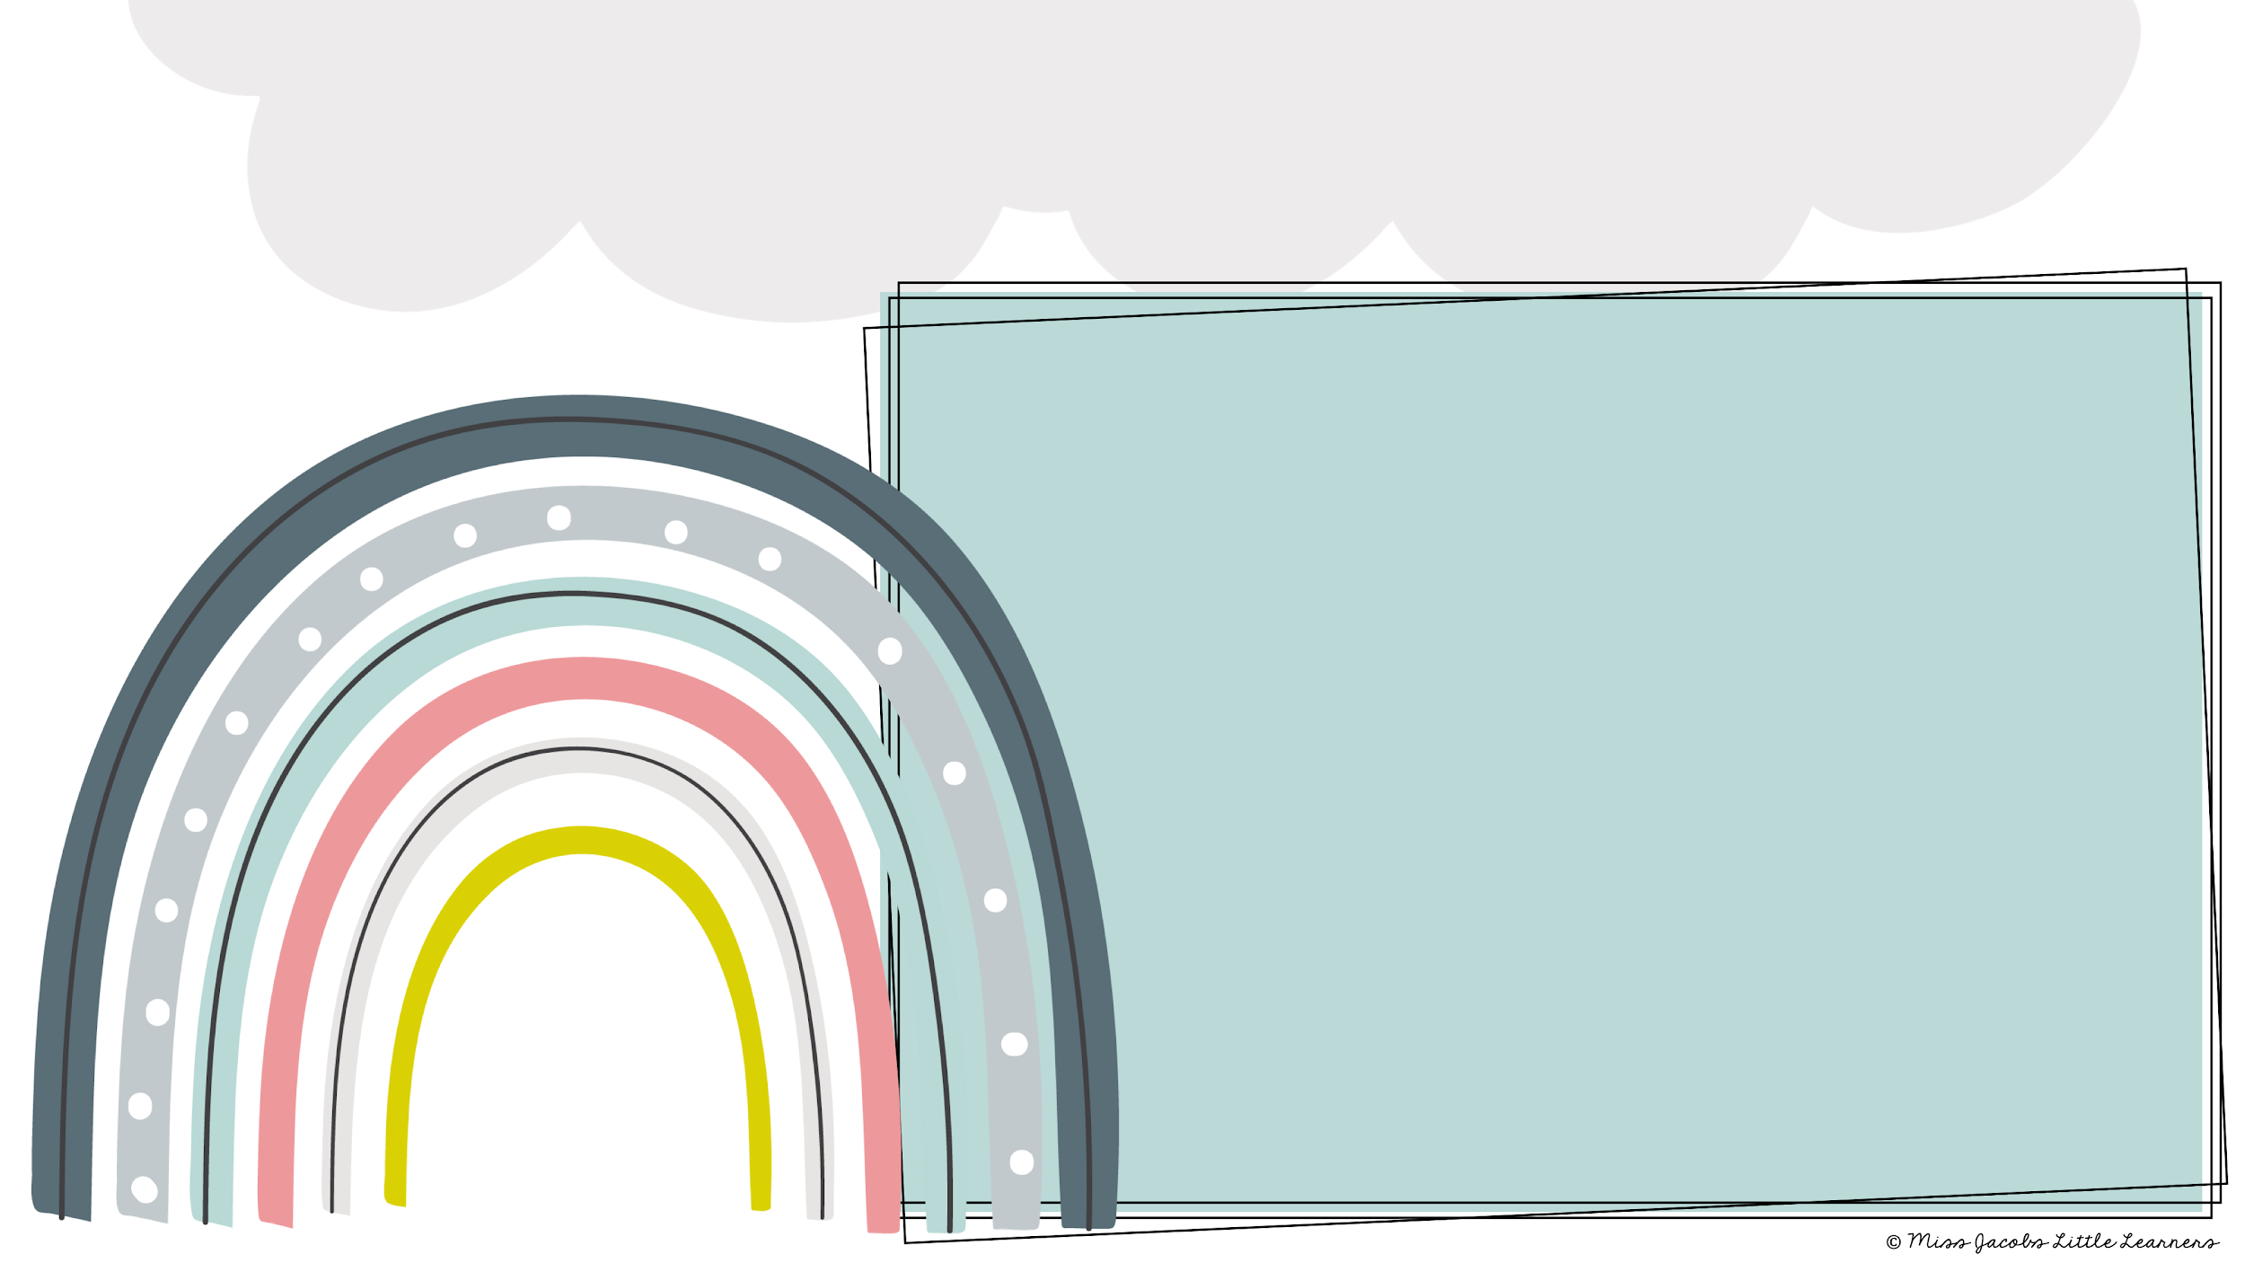
in

Slide 5
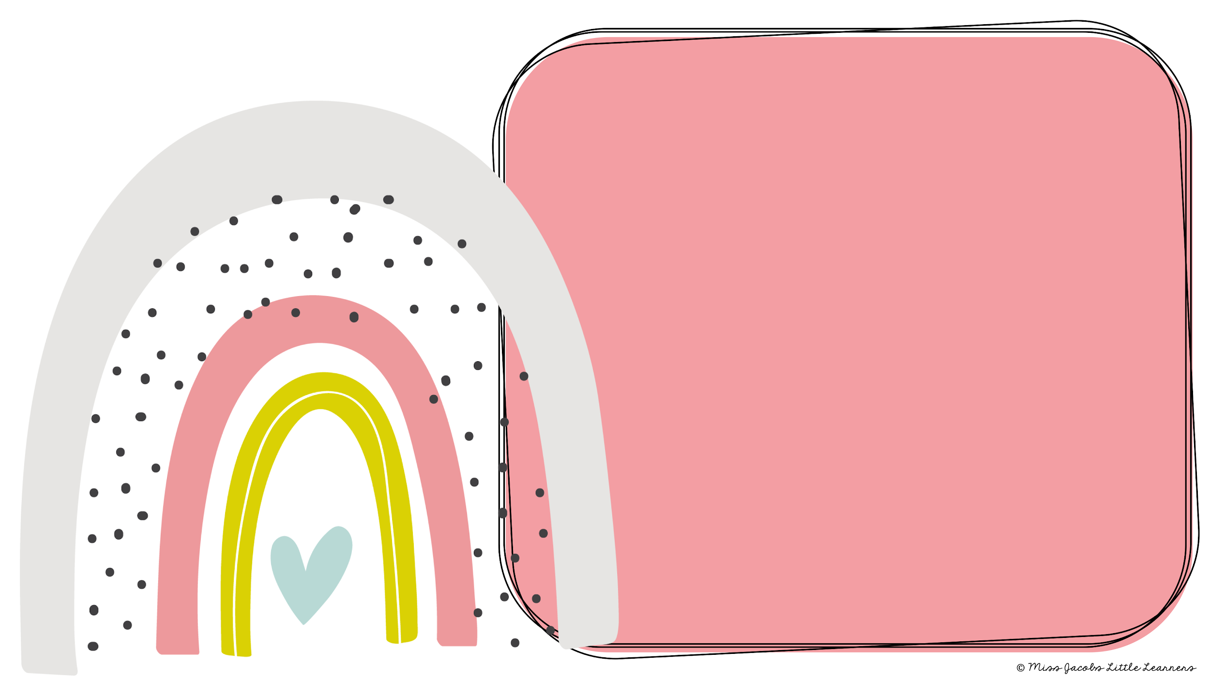
he

Slide 6
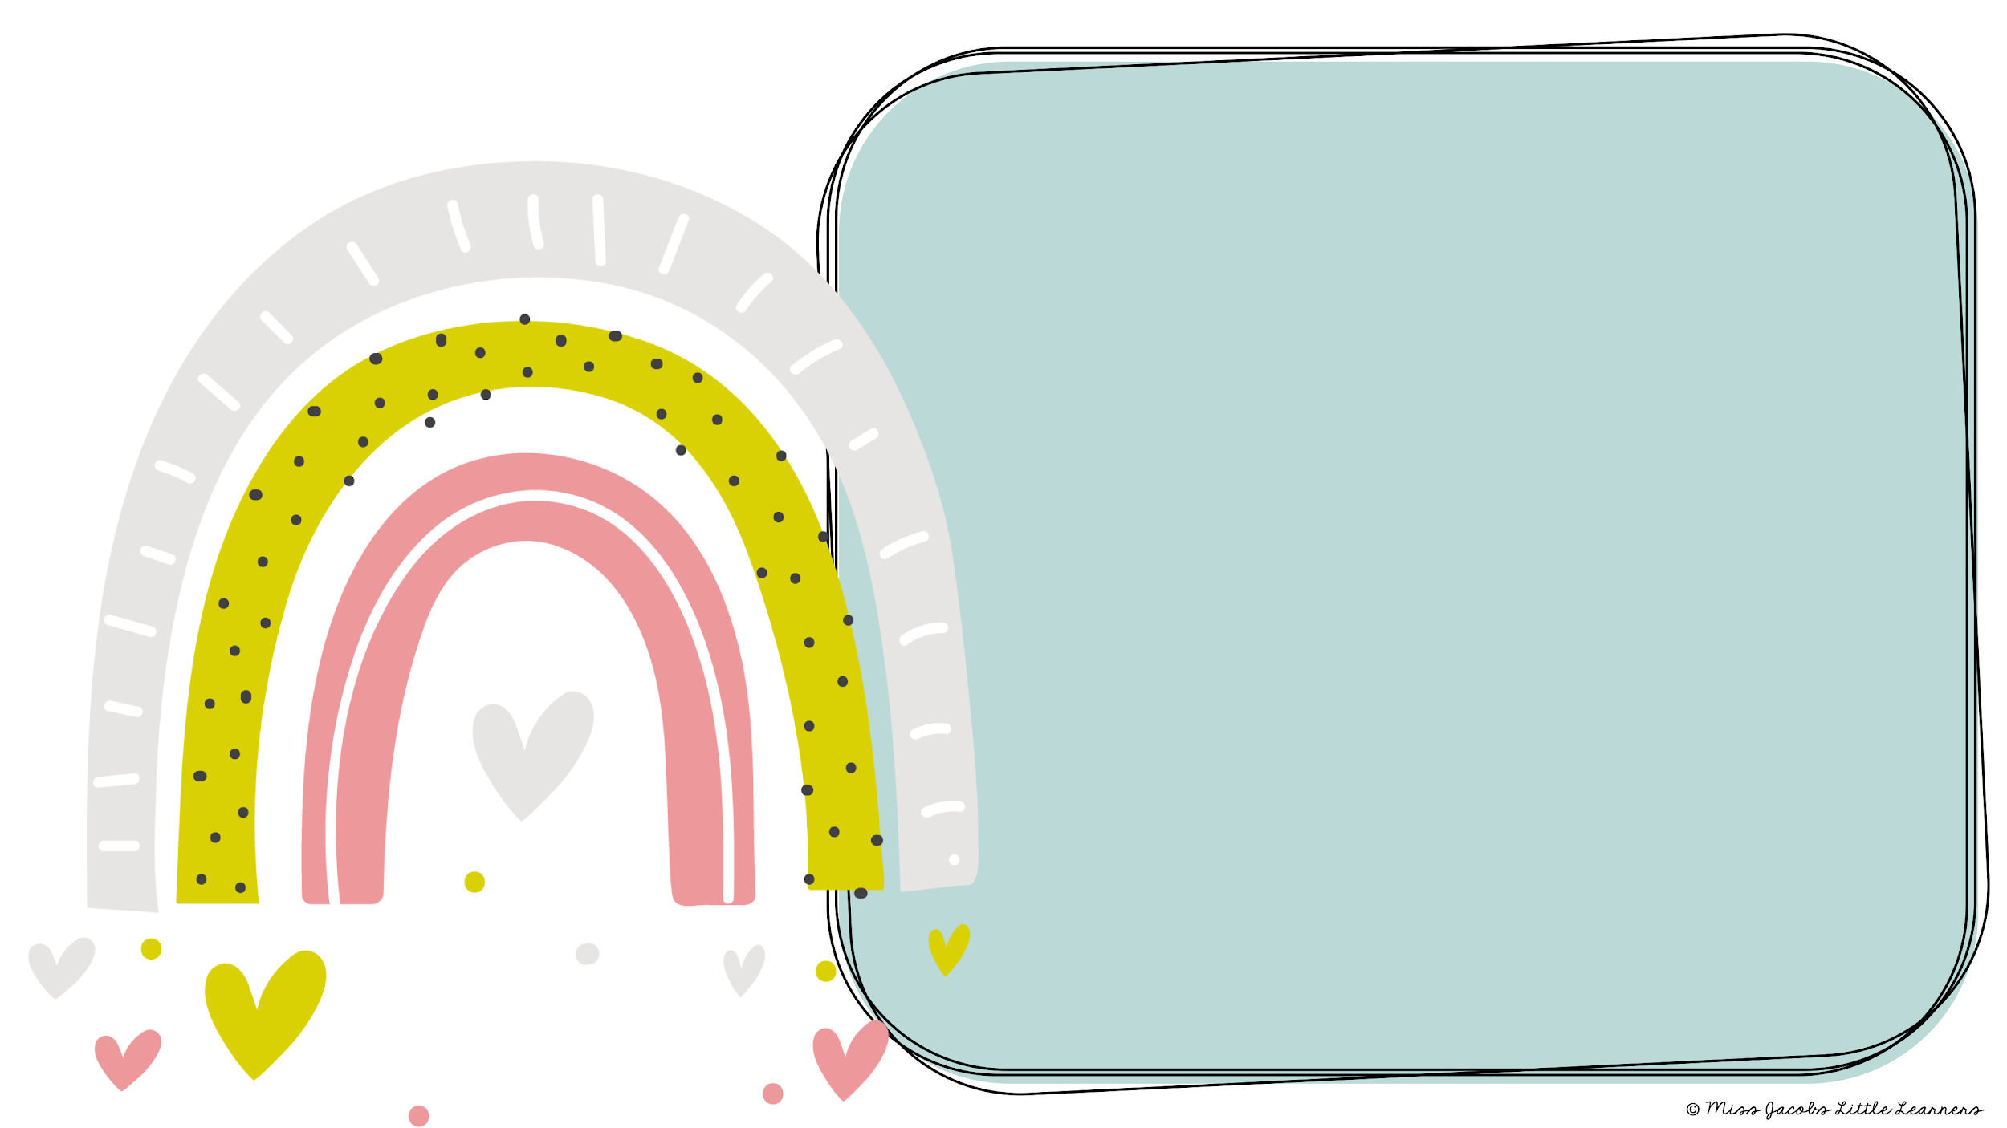
on

Slide 7
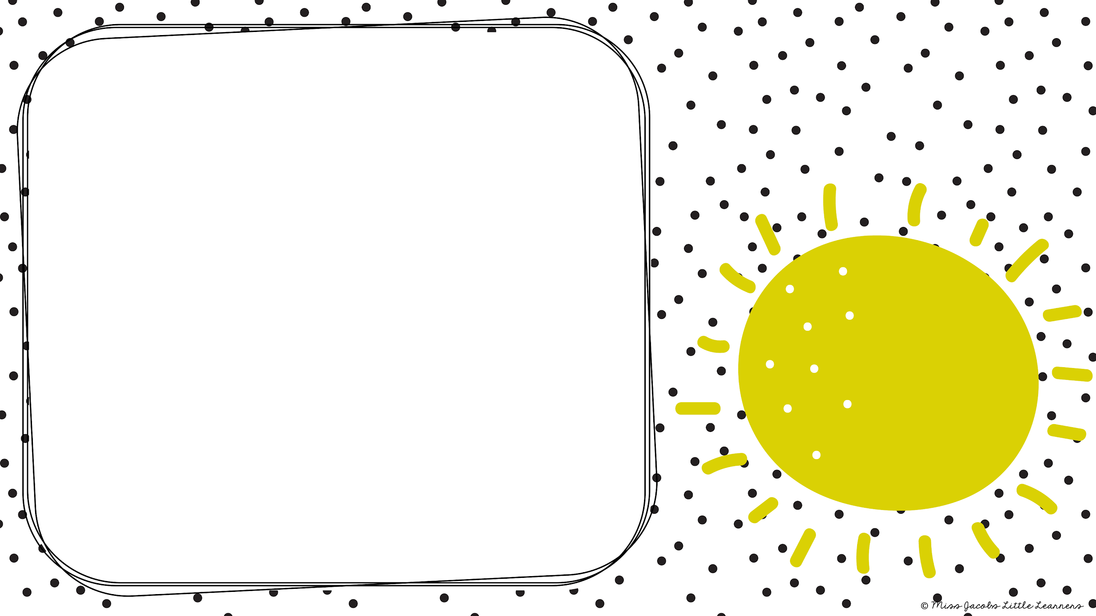
and

Slide 8
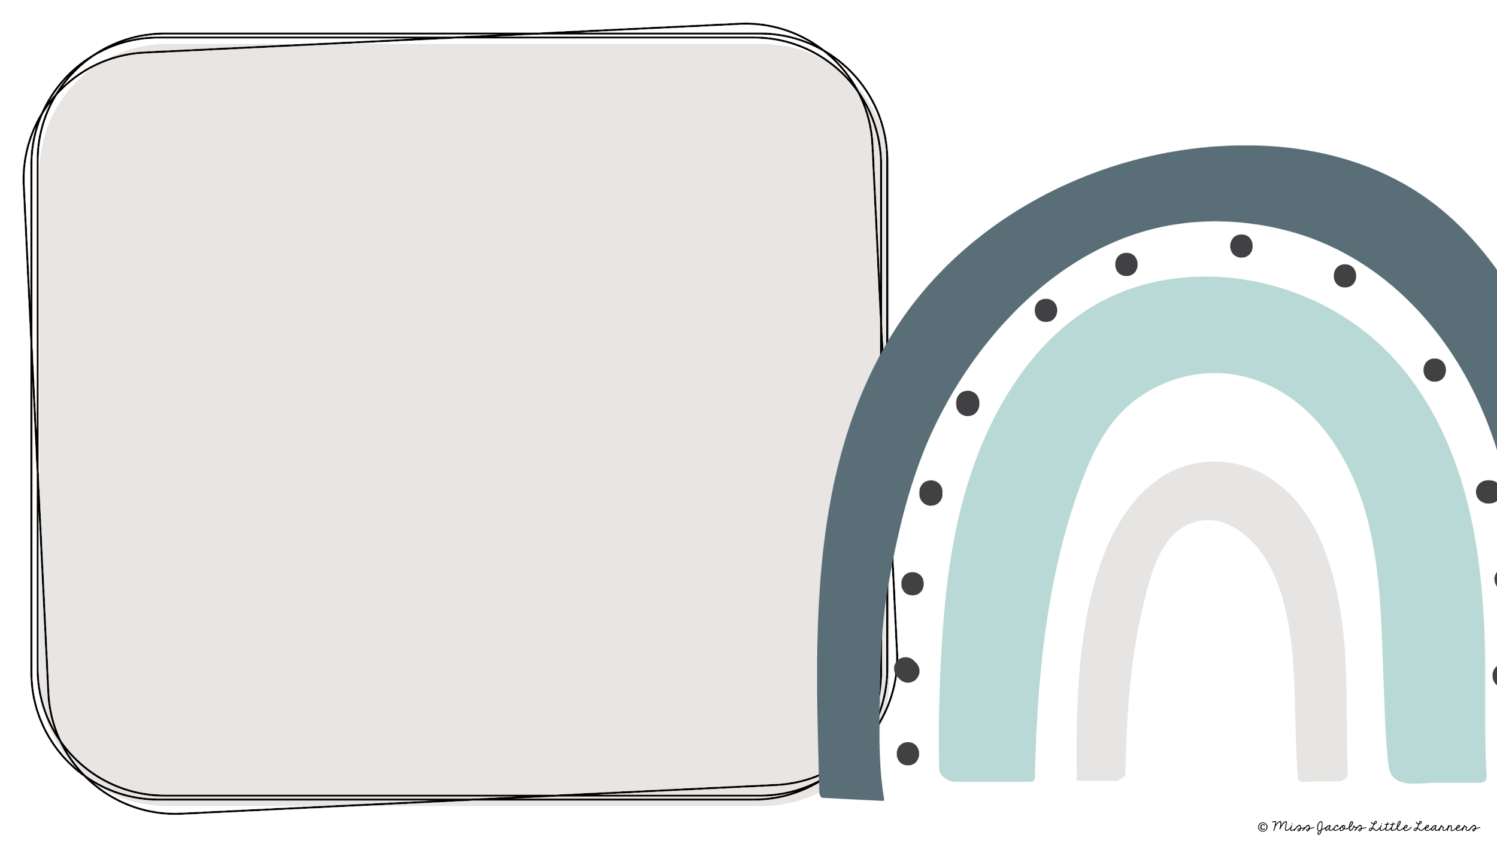
up

Slide 9
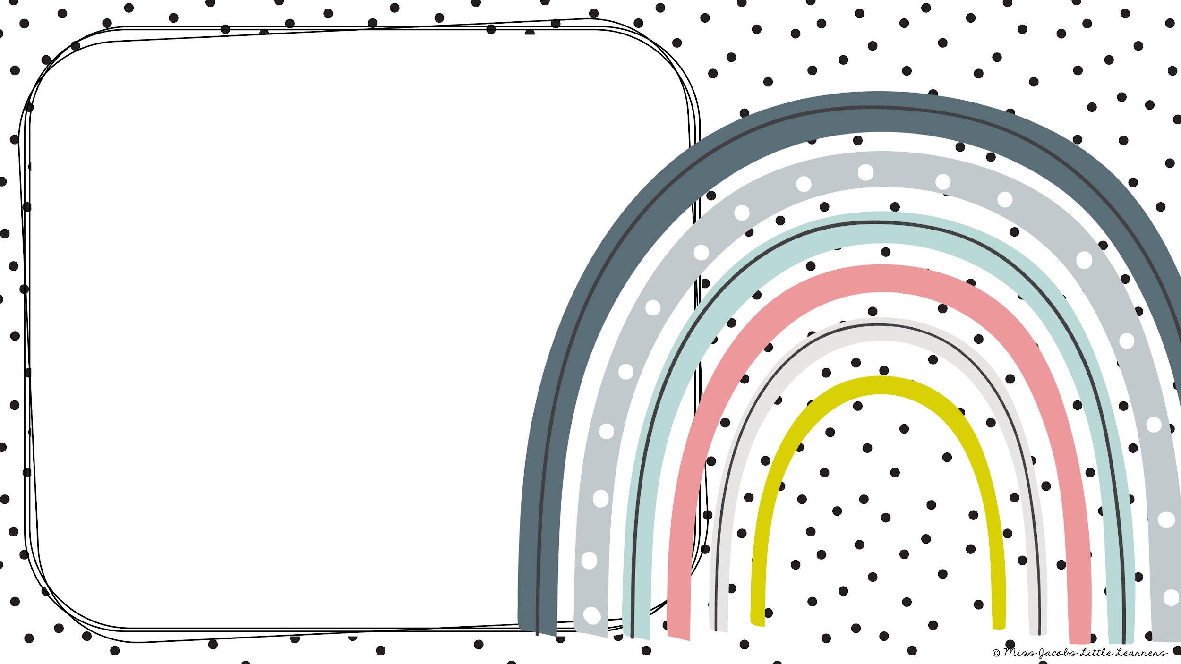
a

Slide 10
you

Slide 11
to

Slide 12
at

Slide 13
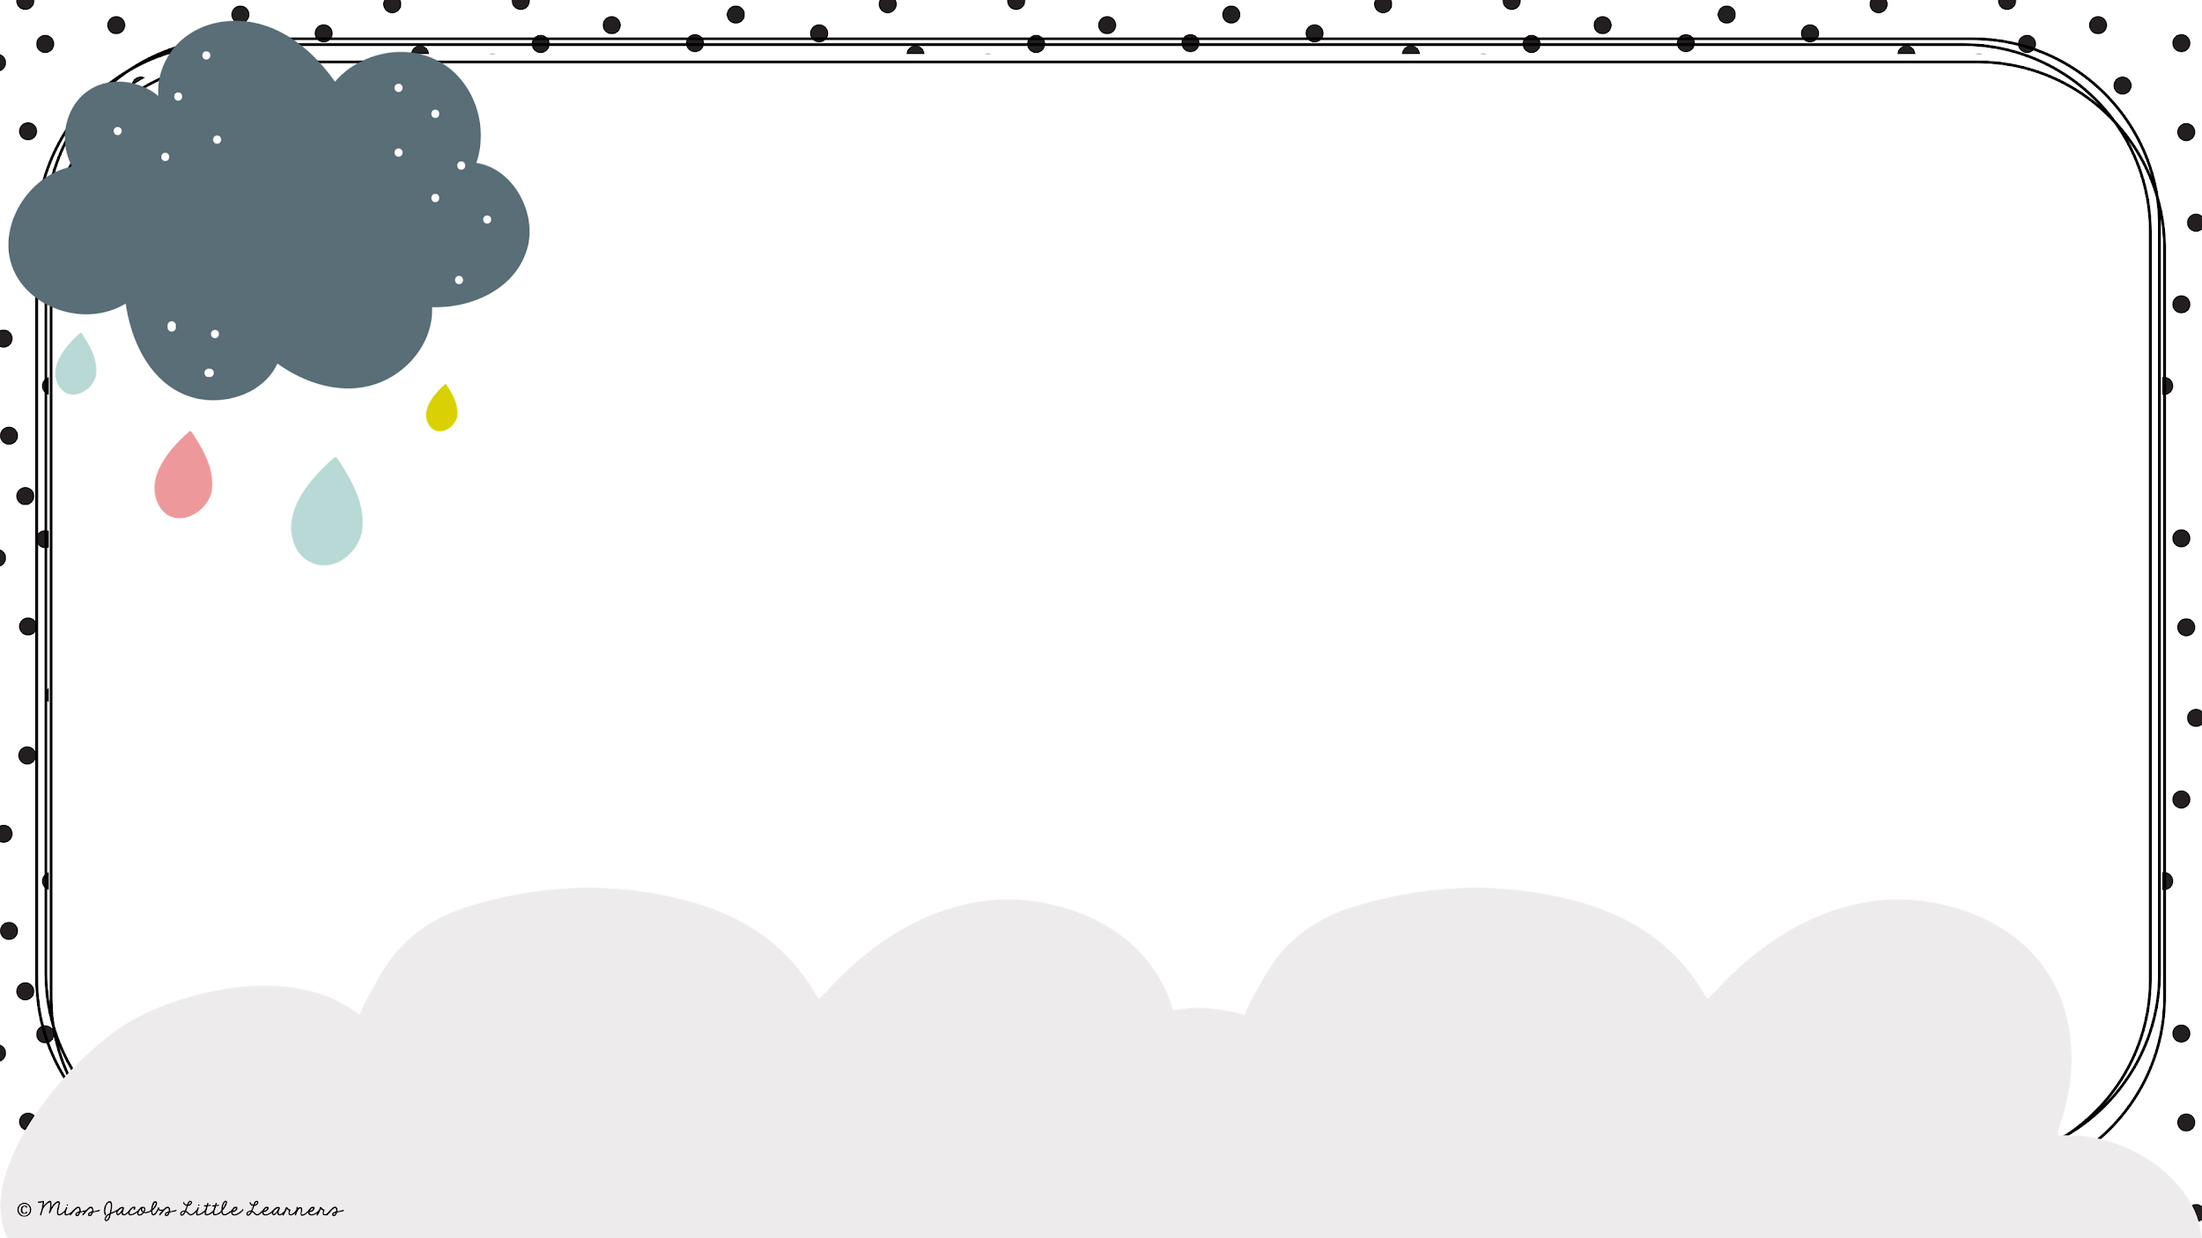
is

Slide 14
it

Slide 15
was

Slide 16
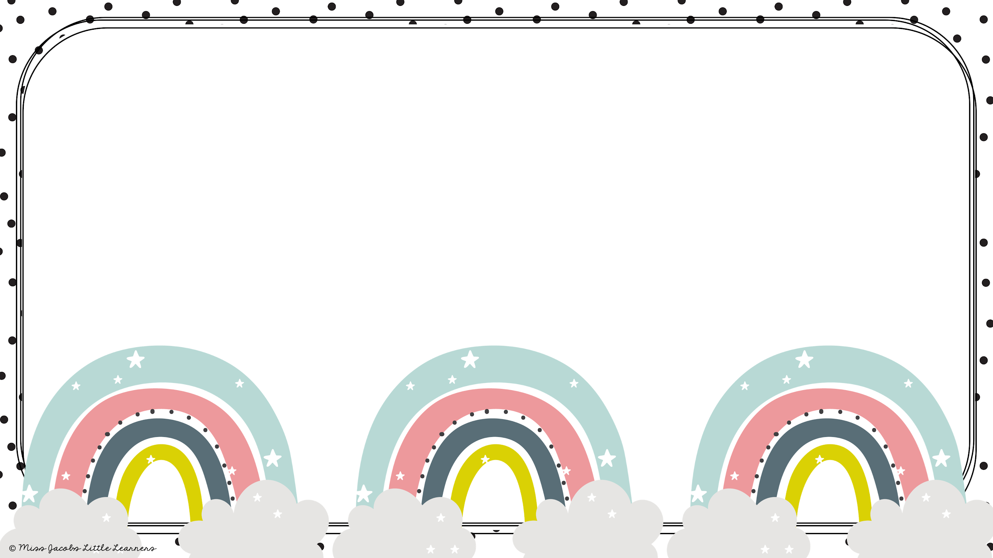
for

Slide 17
or

Slide 18
be

Slide 19
by

Slide 20

are

Slide 21
will

Slide 22
have

Slide 23
once

Slide 24
we

Slide 25
all

Slide 26
but

Slide 27
not

Slide 28
what

Slide 29
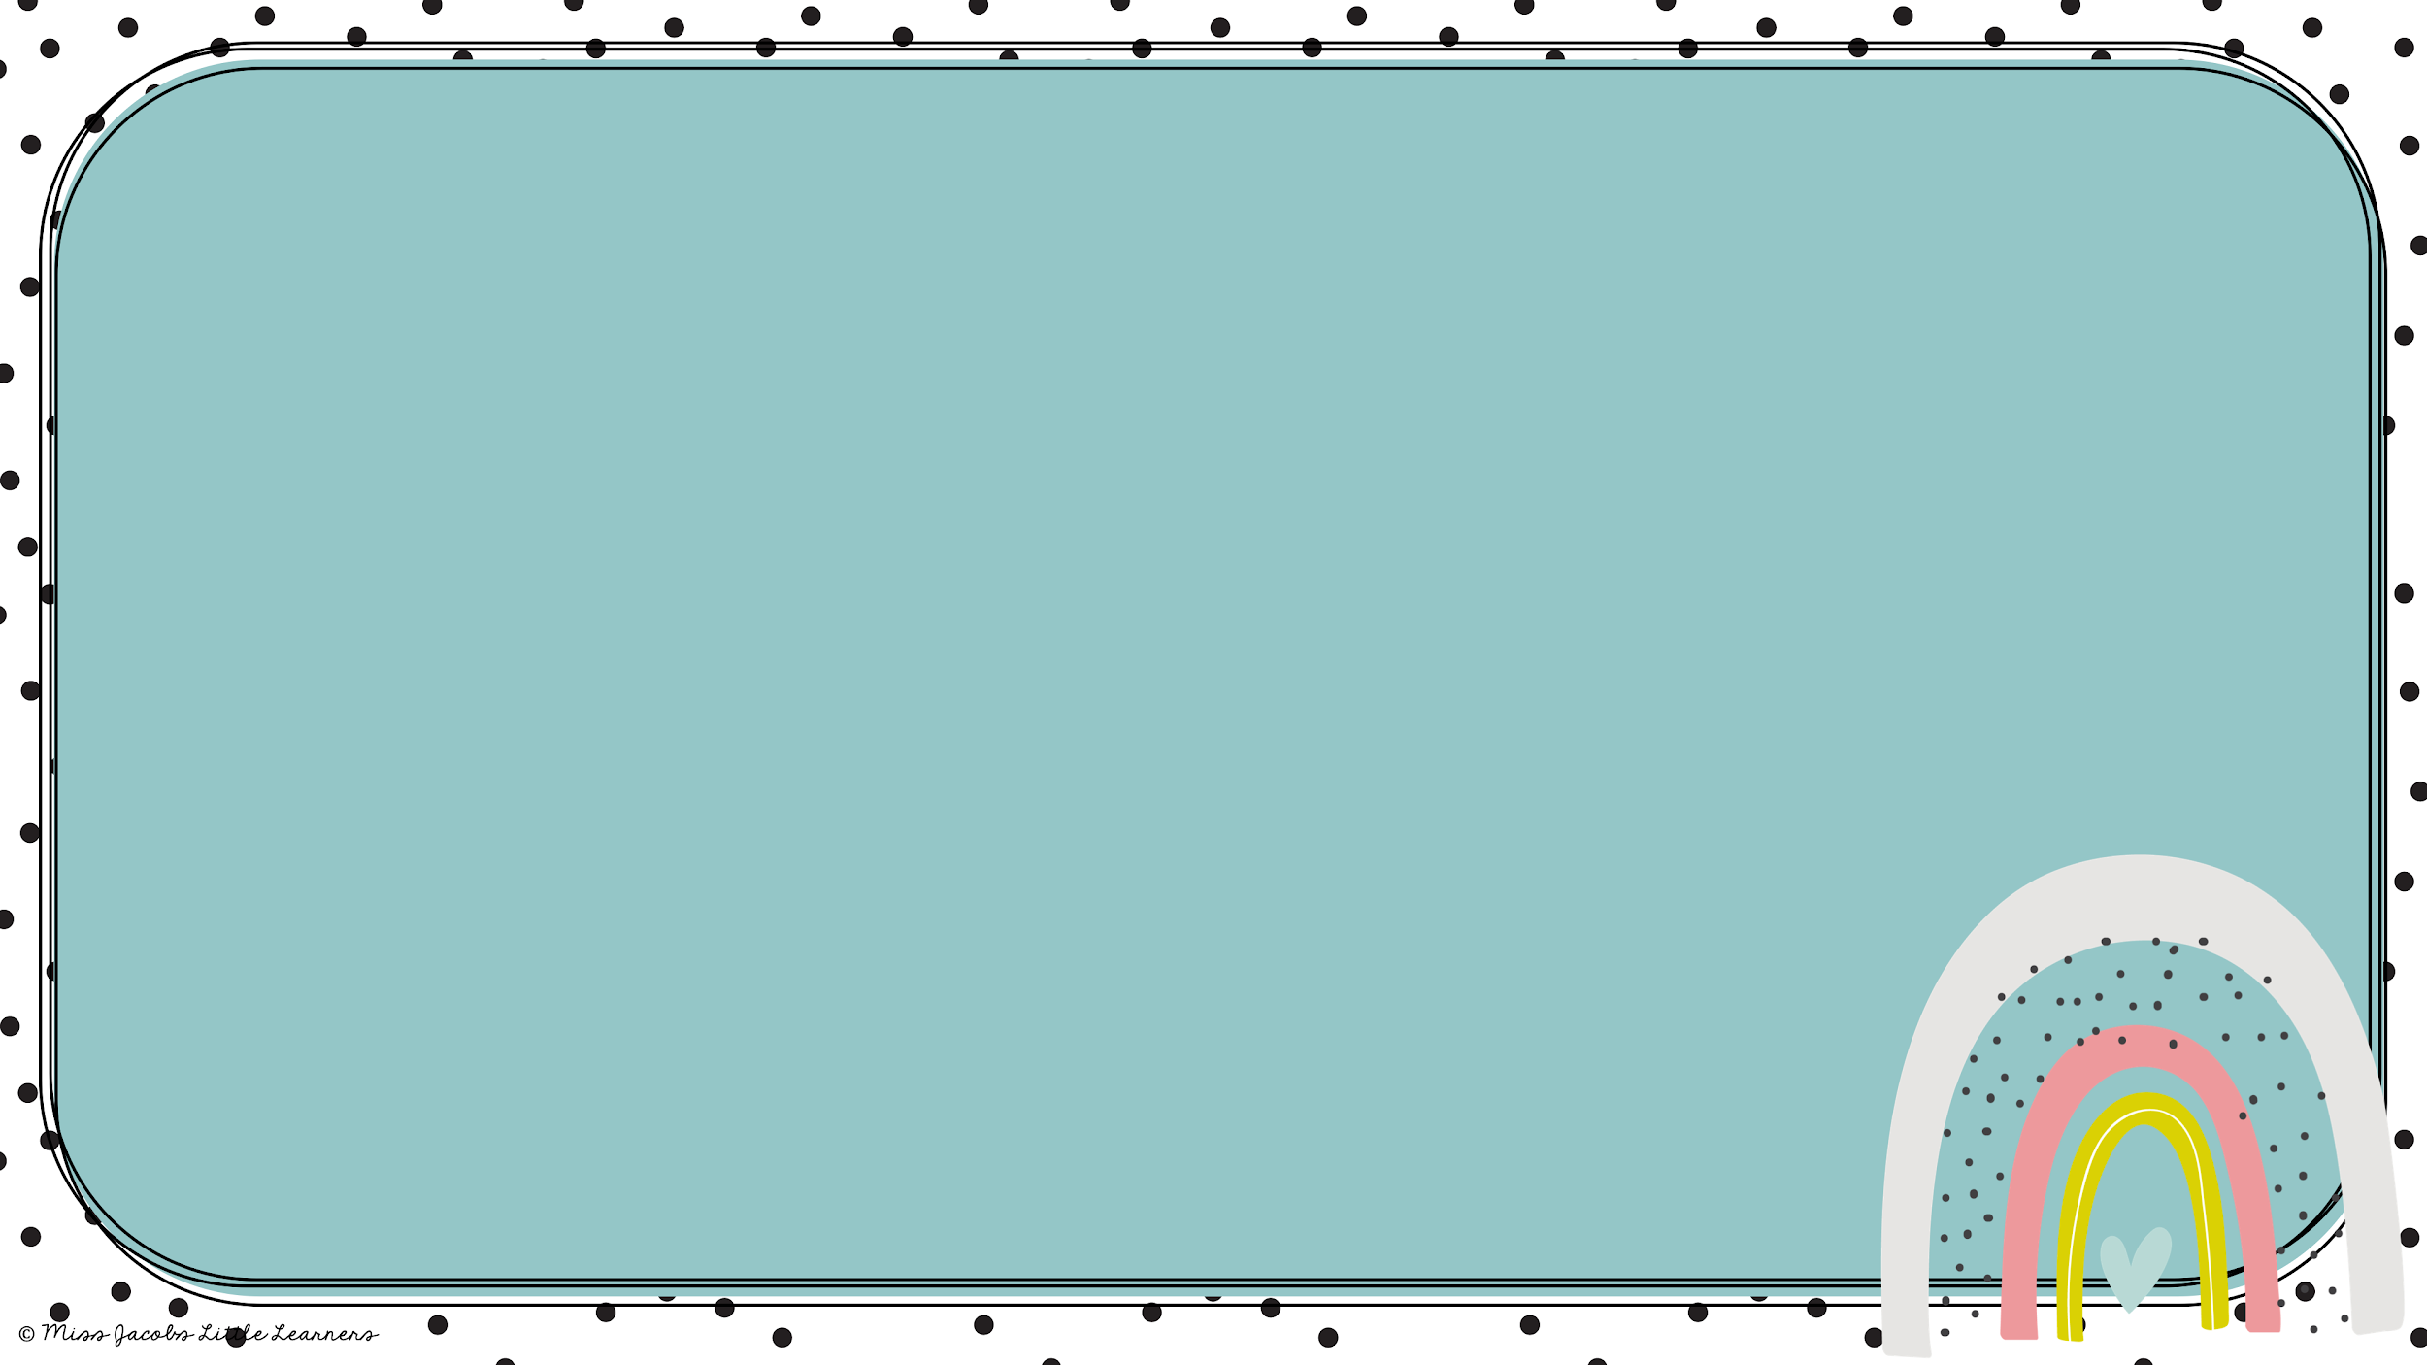
she

Slide 30

like

Slide 31
just

Slide 32
your

Slide 33
out

Slide 34
two

Slide 35
big

Slide 36
had

Slide 37
did

Slide 38
my

Slide 39
him

Slide 40
can

Slide 41

food

Slide 42
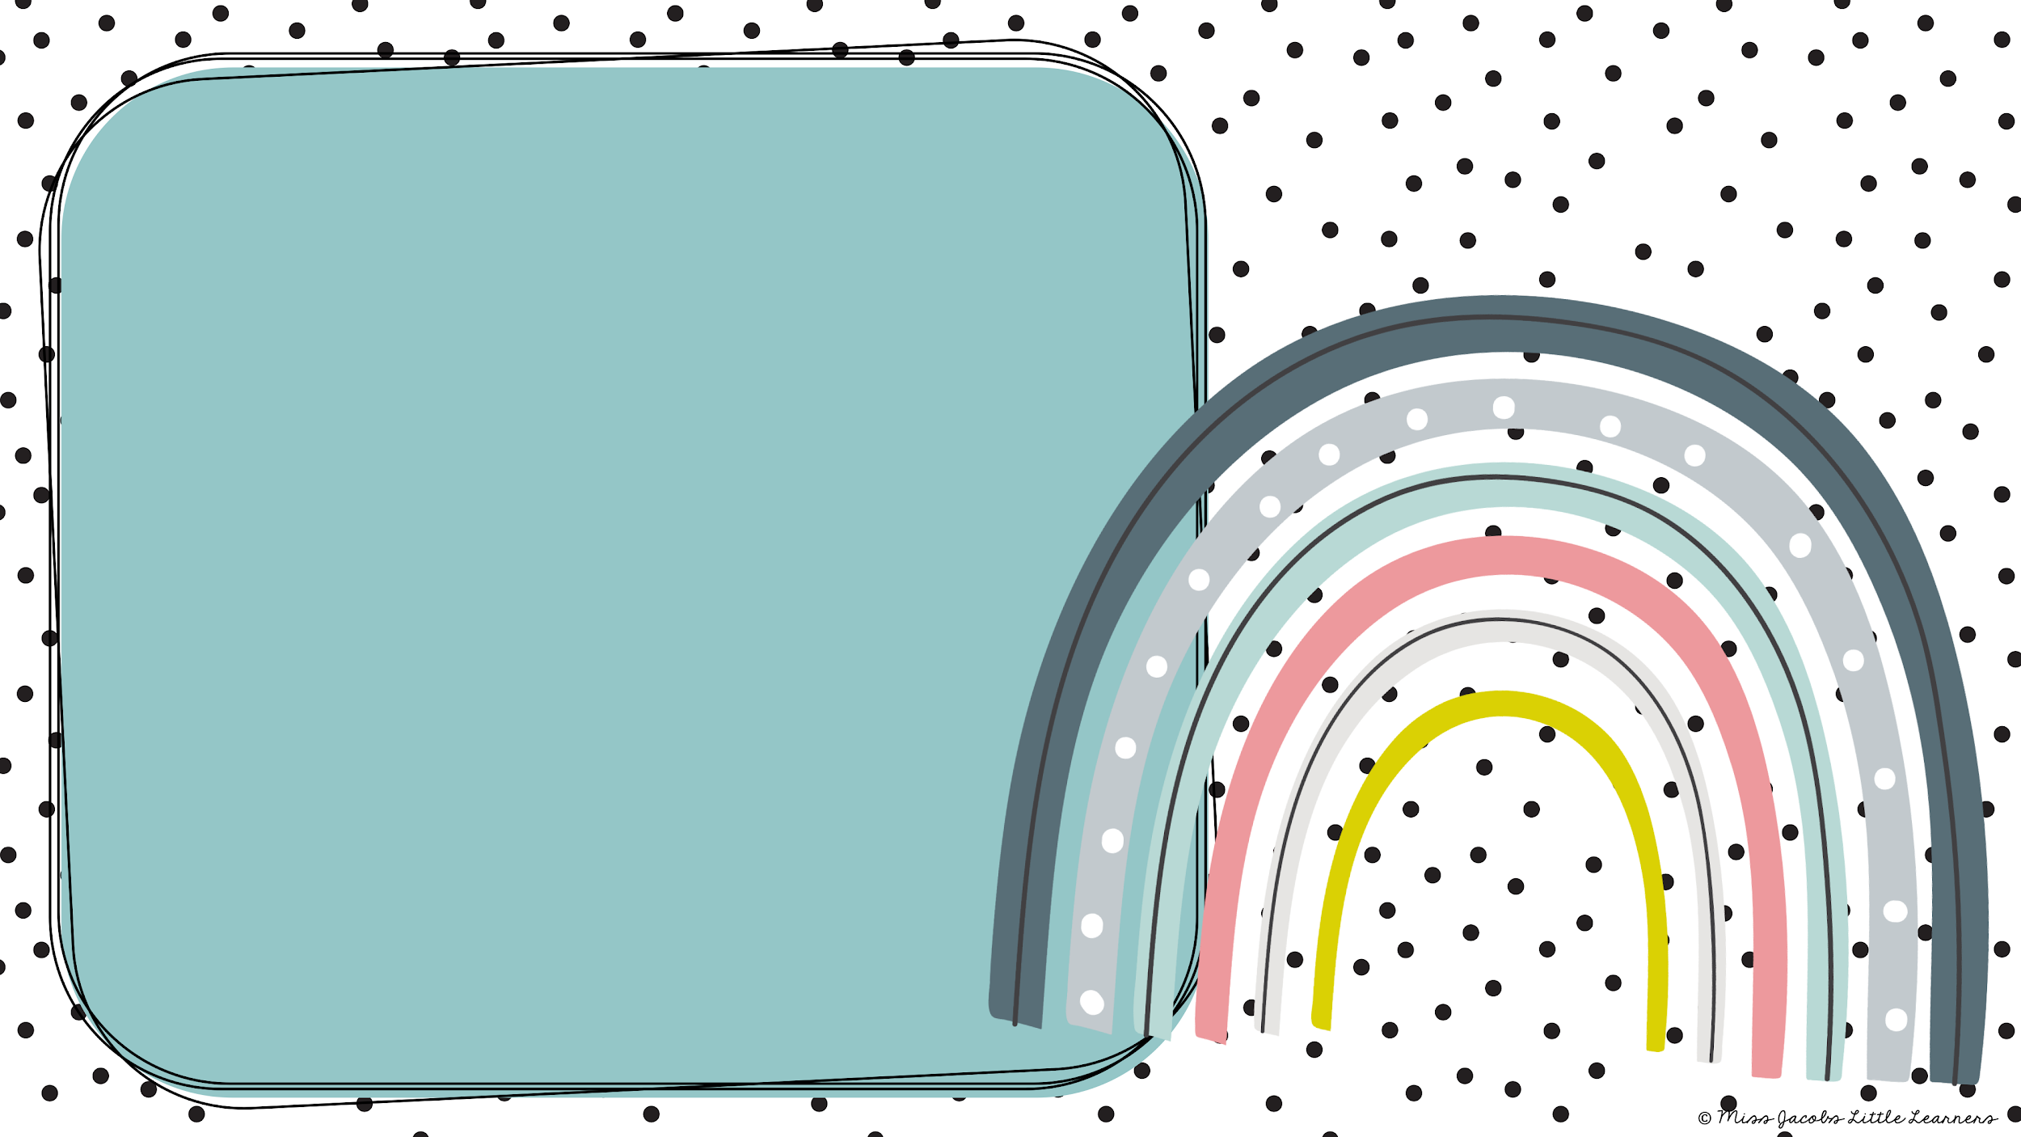
too

Slide 43
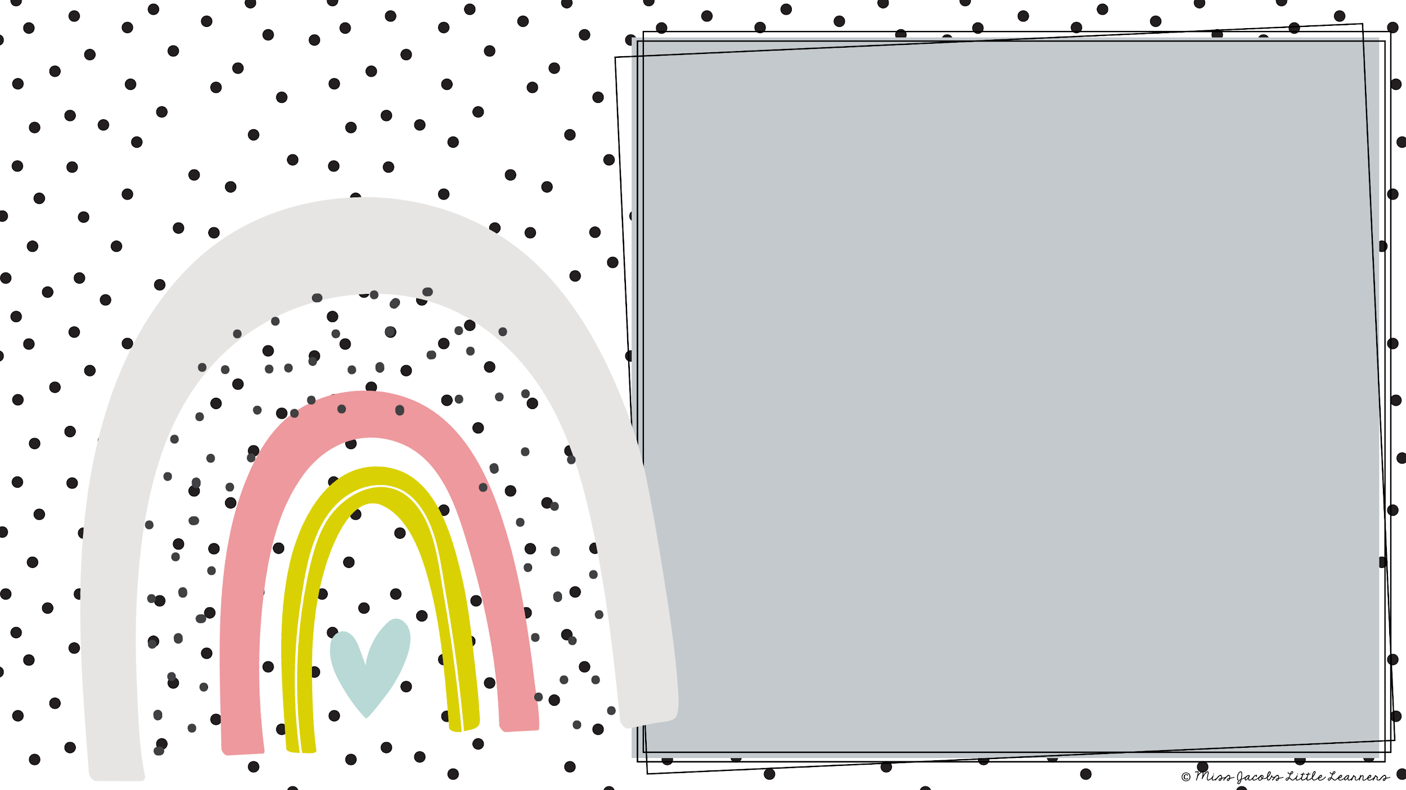
make

Slide 44

look

Slide 45

little

Slide 46
school

Slide 47
so

Slide 48
some

Slide 49
me

Slide 50
if

Slide 51
day

