Slide 1

5th Grade virtual cruise

Slide 2

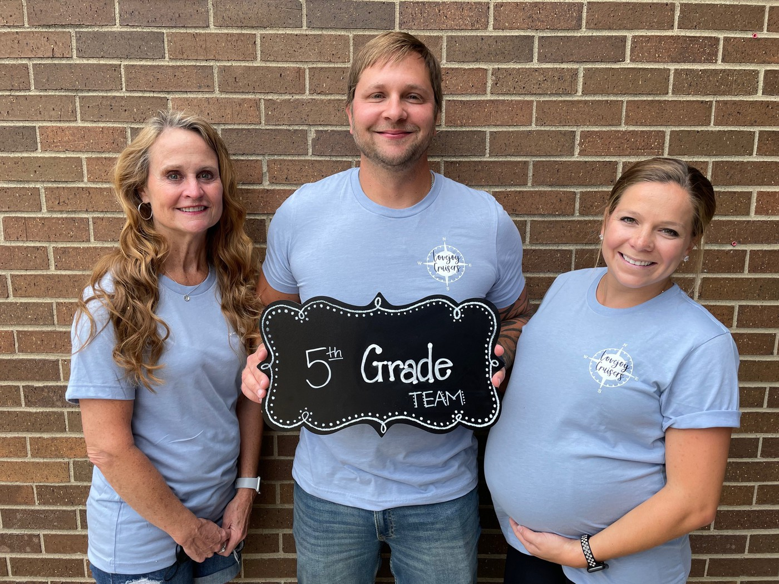

Classroom Teachers
Mrs. fillman
Mr. Chase
Mrs. Jaworski

Slide 3
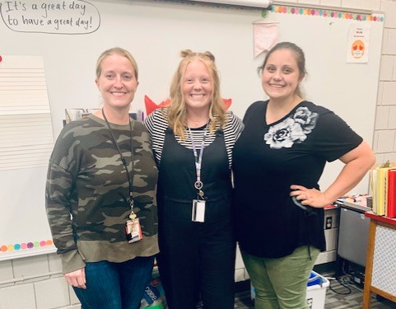
Support teachers
Mrs. Frohling
ELL
Mrs. Slough
Intervention
Mrs. Krischel
SPED

Slide 4
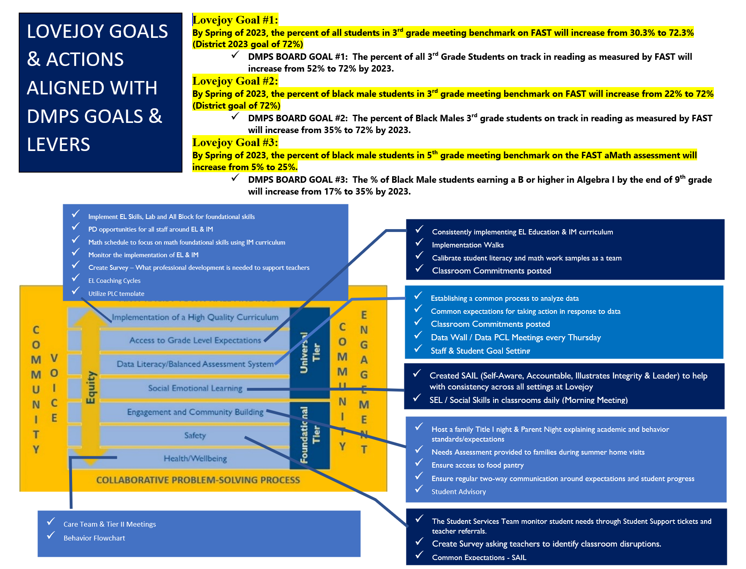
Lovejoy Goals/Actions

Slide 5





EL Education
EL Core
Module 1: Human Rights
Esperanza Rising
Module 2: Biodiversity in the Rainforest
The Most Beautiful Roof in the World
Module 3: Athlete Leaders of Social Change
Promises to Keep
Module 4: The Impact of Natural Disasters
Eight Days: A Story of Haiti
Notes:
Each module is approximately 6-8 weeks of instruction.

Slide 6
EL Education
ALL Block
Additional Work with Complex Text
Reading and Speaking Fluency/GUM (Grammar, Usage, and Mechanics)
Writing Practice
Word Study and Vocabulary
Independent Reading
Notes:
The ALL Block has five components: Additional Work with Complex Text; Reading and Speaking Fluency/GUM (Grammar, Usage, and Mechanics); Writing Practice; Word Study and Vocabulary; and Independent Reading.

Slide 7
IM Math
8 Units
Finding Volume
Fractions as Quotients and Fraction Multiplication
Multiplying and Dividing Fractions
Wrapping Up Multiplication and Division Multi-Digit Numbers
Place Value Patterns and Decimal Operations
More Decimal and Fractions Operations
Shapes of the Coordinate Plane
Putting It All Together

Slide 8
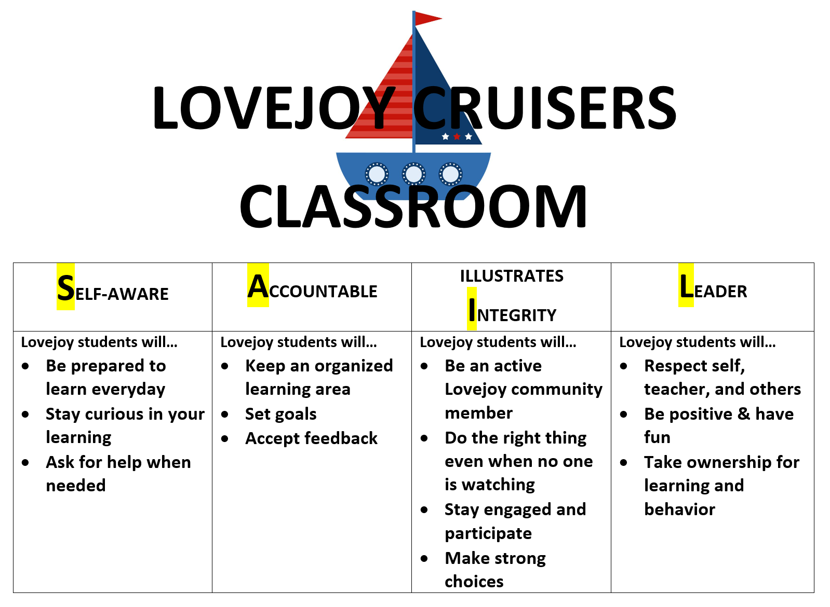
SAiL
Self-aware accountable illustrates integrity leader

Slide 9

Expectations
Notes:
Classroom expectations are consistent with SAIL expections. In 5th grade we teach students to have a growth mindset when learning new things instead of having a fixed mindset. We all have the ability to learn some new even when it seems difficult at first

Slide 10
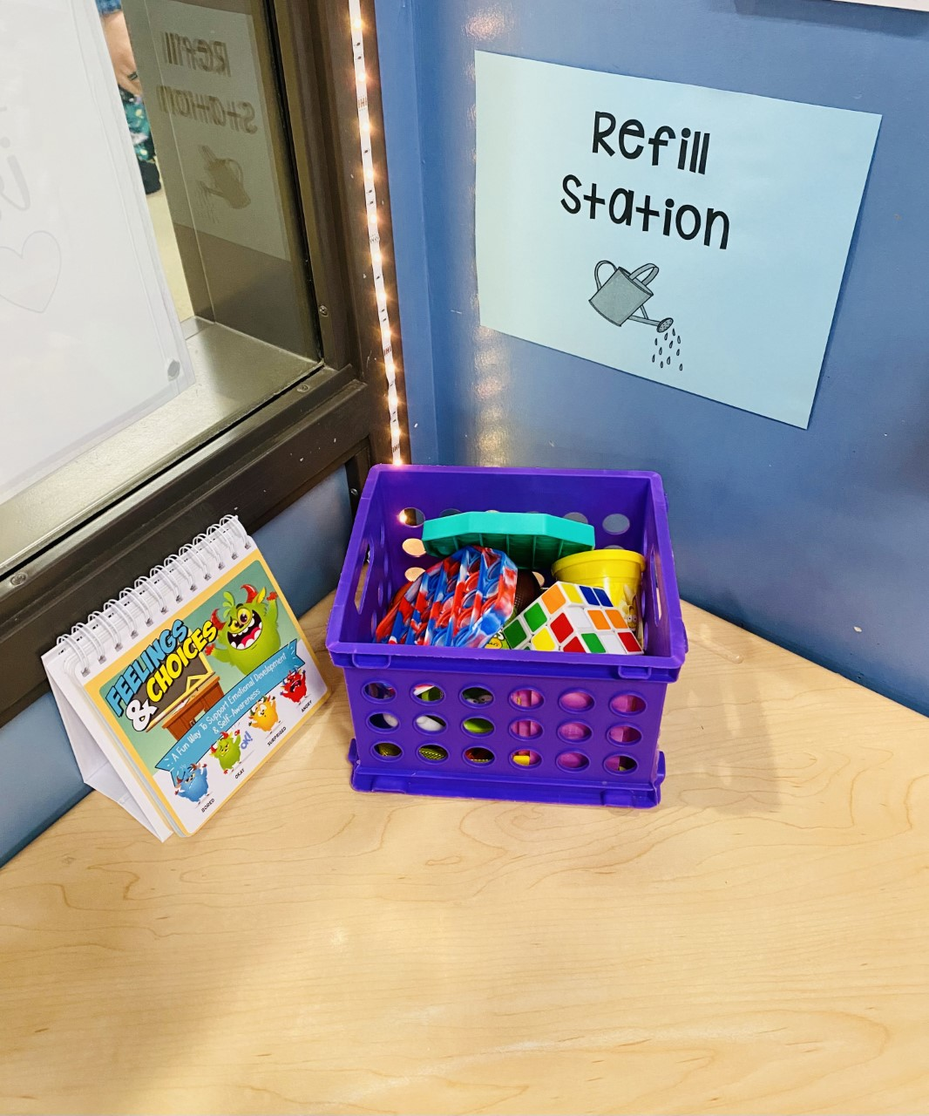

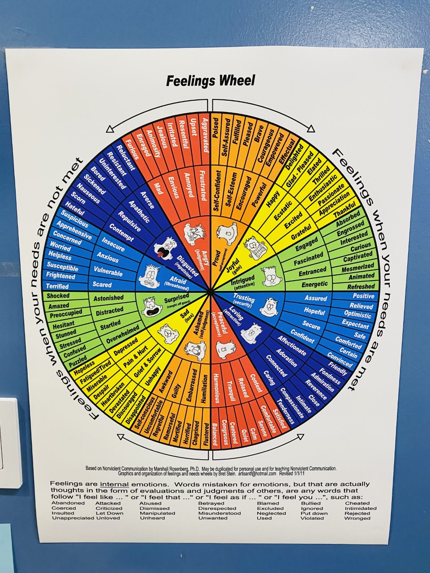
Refill station
Notes:
The refill station is a places where students can go to take a few minutes to recharge. When a student is feeling overwhelmed and in need of a break, this is a great option for them right in the classroom. There are figets for them to use and empotion regulators as well.

Slide 11
yardsticks
CBMr Assessment:
Fall- 132
Winter- 149
Spring- 162
aMath:
Fall- 213
Winter- 216
Spring- 218
Notes:
Yardsticks are the benchmarks for testing. We assess student progress three times a year. Students scores reflect if they are growing at the rate they should be for the year. We assess students in math and reading three times a year.

Slide 12
-Flashcards
-READ 20 MINUTES A DAY
Online Resources:
-Elementary student resources website https://www.factmonster.com/math/flashcards https://www.splashlearn.com/math-skills/math-facts https://www.roomrecess.com/mobile/FastFacts/play.html
What can students do at home?
Notes:
Krischel

